Slide 1

Business Analyst Career Program – Capstone Project
Western Countries Financial Data - Analysis
By – Muskan Bansal

Slide 2
INDEX
Project Summary
Data Exploration And Graphical Analysis Using Excel
Statistical Analysis Using Excel
Insert the given Data into the SQL Server (Queries)
Import the Data from the SQL Database into Power BI
Interactive Dashboard by using Visualization Tools
Conclusion and Inferences
Endnotes

Slide 3
1. Project Summary
Business Analyst Career Program Capstone Project is the final project marking completion of our Business Analyst Career Program. We have completed the Project by using our Analytical Skills and Tools we have learned in the course. In this Capstone Project, I have provided Sales Data of various Bicycles Brands in different Countries. I have provided useful insights from the available data and presented it in a systematic manner as instructed in the Project guideline.
This PowerPoint presentation includes :-
- Explored, Clean and Summarized Data.
- Statistical Analysis with various Statistical Tools.
- Graphical Analysis using Excel to derive Insight.
- Data in SQL server and performing Queries.
- Data in Power BI and Interactive Dashboard.
- Conclusion and Inferences from the Dashboard.
- Links for source files for Reference.

Slide 4
Information About The Dataset
An Excel spreadsheet containing a Dataset – Western Countries Financial Data has been provided.
This Dataset is about the Sales Data of different Bicycles Brands in different Countries.
The Data contain :-
16 Columns
700 Rows
16 Columns are divided in Dimensions And Measures.
There are 6 Dimensions, Named - Segment, Country, Product Discount Band, Date, Month Name
There are 10 Measures, Named – Units Sold, Manufacturing Price, Sale Price, Gross Sales, Discounts, Sales, COGS, Profit, Month Number, Year.

Slide 5
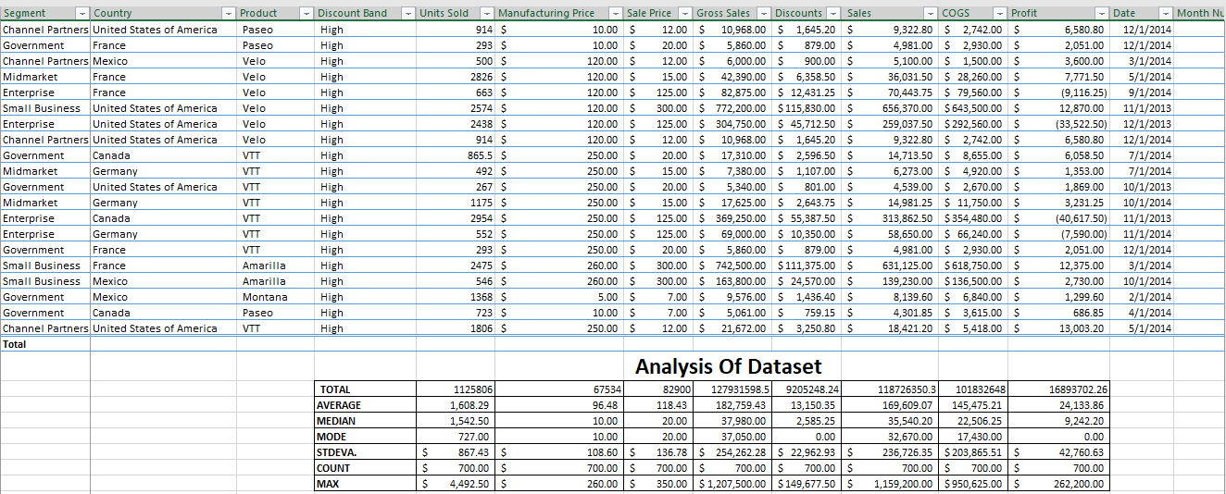
- To Analyze the Dataset Excel built-in features and functions are used.
- Sum, Average, Median, Mode, Standard Deviation, Count and Maximum for Dimensions has been calculated.

Slide 6
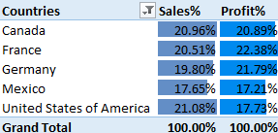
2. Data Exploration And Graphical Analysis Using Excel
Data Analysis of sales
Segment : Channel Partners, Enterprise, Government, Midmarket, Small Business
Countries : Canada, France, Germany, Mexico, United States of America
Product : Amarilla, Carretera, Montana, Paseo, Velo, VTT
Exploration of Data with Graphical Analysis
1. The share of Sale and Profit Earned in all countries are almost same.

Slide 7
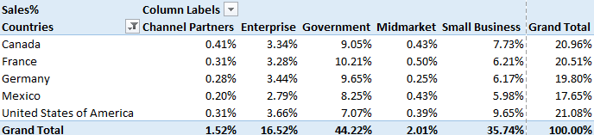
2. Sales In Segments In Different Countries :
- Channel Partner Segment has least share of sales in every country Except Germany where Midmarket segment has the least sales share.
- Government Segment has most share of sales in every country except USA.
- Small Business Segment has most share of sales in USA.
- It is observed that all segment have almost same share in total sales in each country.

Slide 8
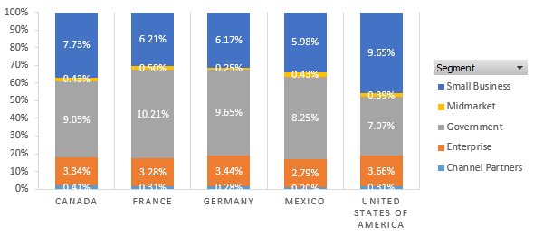
3. Profit Percentage of Different Segment In Different Countries :
Enterprise Segment is loss making in every country.
Government Segment earns the most profit in every country.
Small Business Segment is showing fair Profit.
Channel Partners Segment is least profit making.

Slide 9
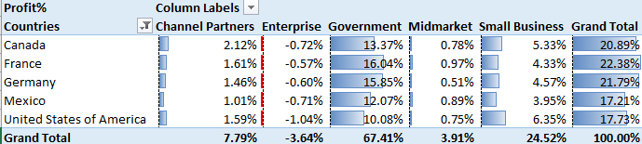
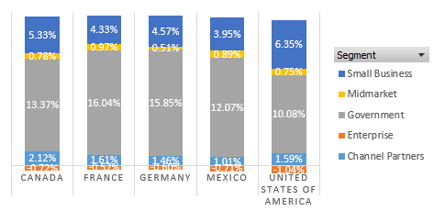

Slide 10
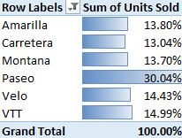
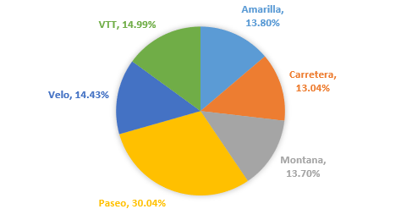
4. Product V/s Unit Sold
Paseo is most sold product with 30% in unit sold.
Other products sales are almost equal to each other.

Slide 11
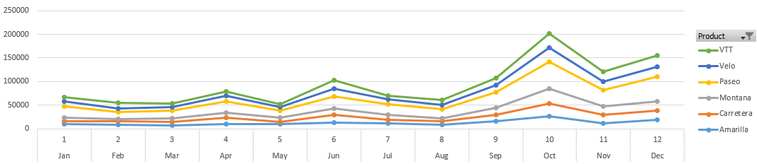
5. Sales Trend Of Each Product
Paseo is most sold product in the time period between September 2013 to December 2014.
Paseo is shows steep increasing sales trend with High Variation each month.
Other products show almost same sales variation and trend.

Slide 12
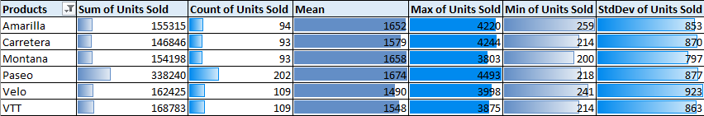
3. Statistical Analysis Using Excel
Statistical Analysis On Basis Of Units Sold Of All The Products
Paseo is the highest sold product, rest all product are sold in almost same amount.
Velo has the least amount of sell.

Slide 13
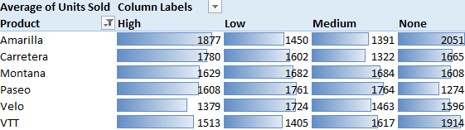
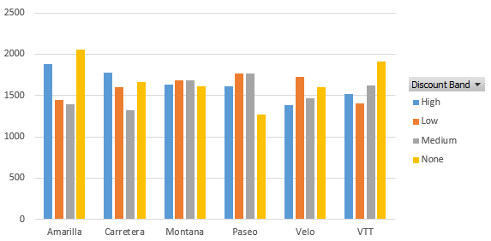
Units Of Products Sold By Discount
There is no major difference between units of products and discount.

Slide 14
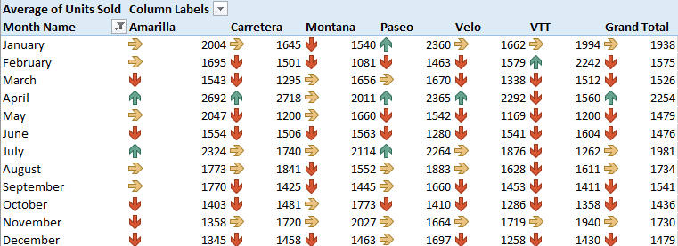
Average of Units Sold By Months
Month of April has the highest sales among all the moths for all the products.
January and November months has the moderate sale.
Remaining months shows downturn of the products sold.

Slide 15
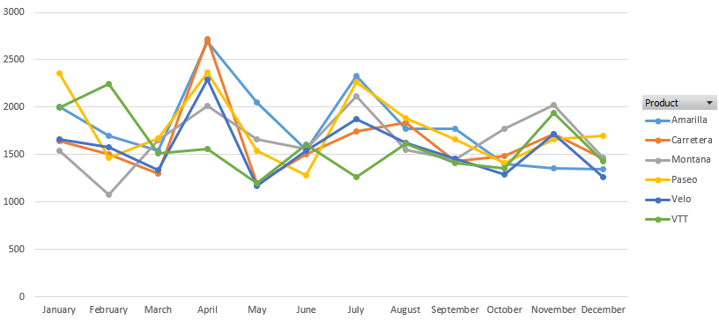

Slide 16
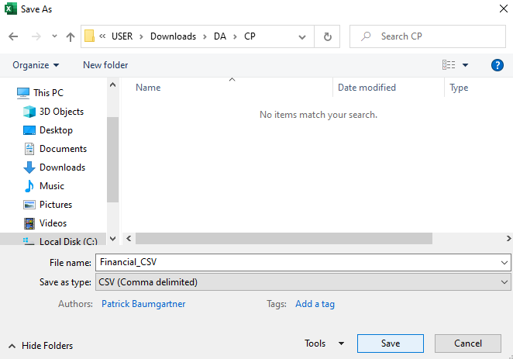
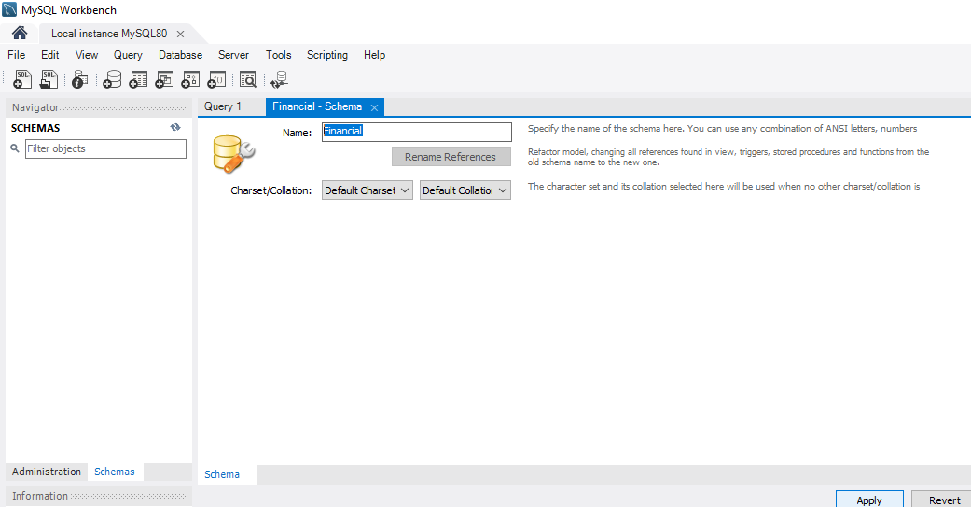
4. Insert the given Data into the SQL Server (Queries)
Inserting Data in MySQL
1 Step: Saving “Western Countries Financial Data” as CSV format
File> Save As> Save as type
2 Step: Creating New Schema in MySQL with Name: Financial

Slide 17
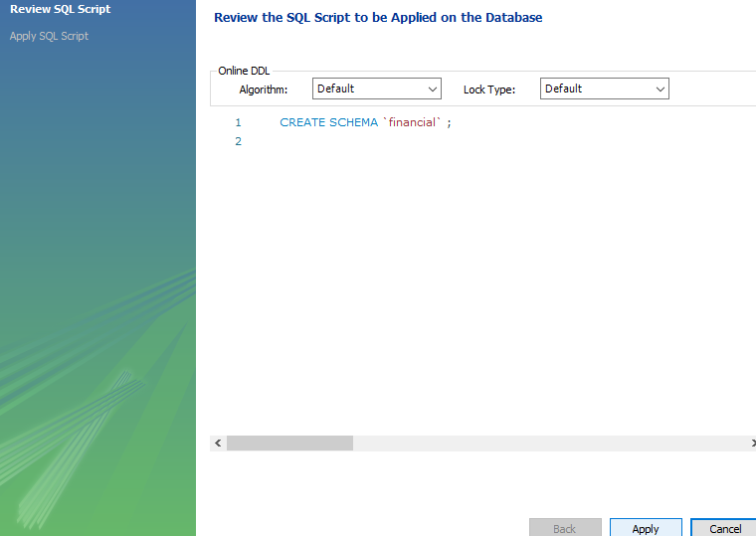
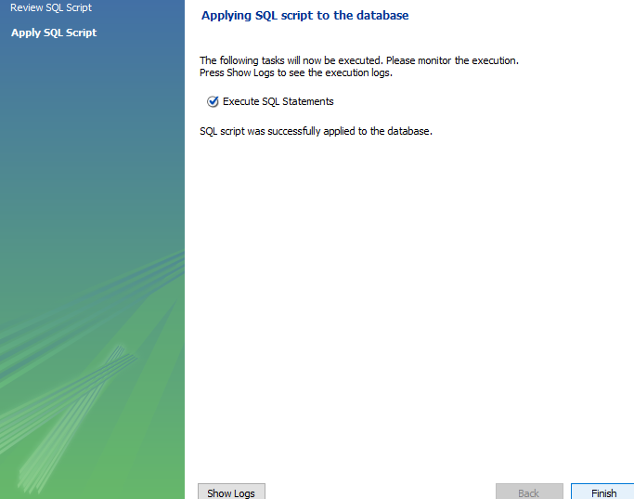

Slide 18
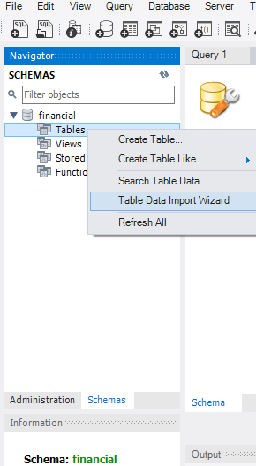
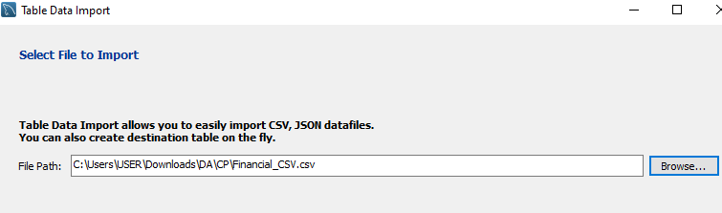
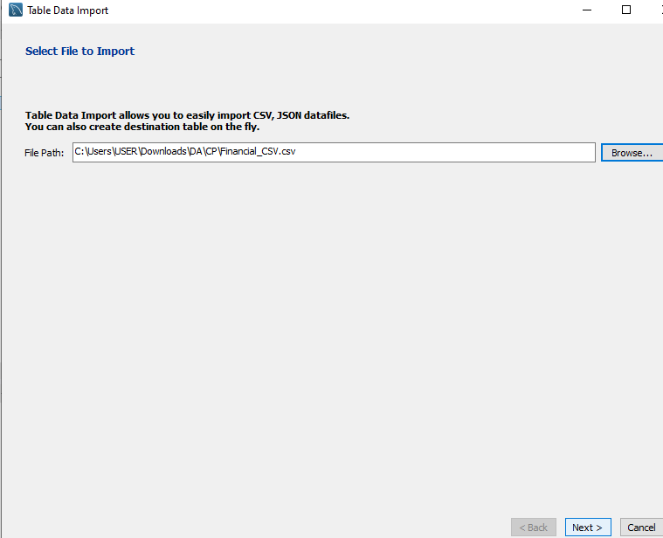
3 Step : Upload Data – Schema>Table>Table Data Import Wizard>Browse & Select File>Next>Next>Next>Next>Next>Finish

Slide 19
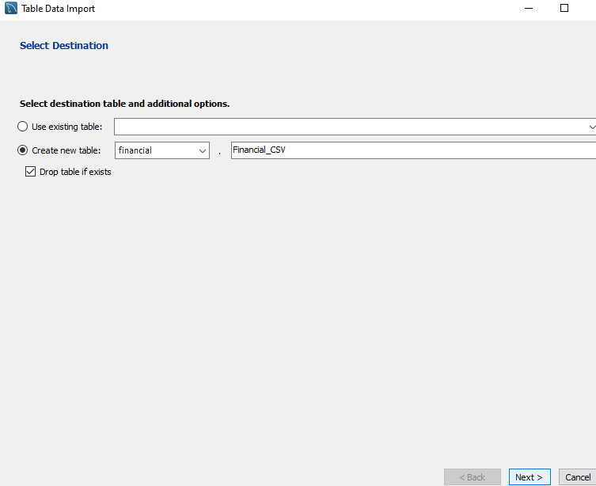
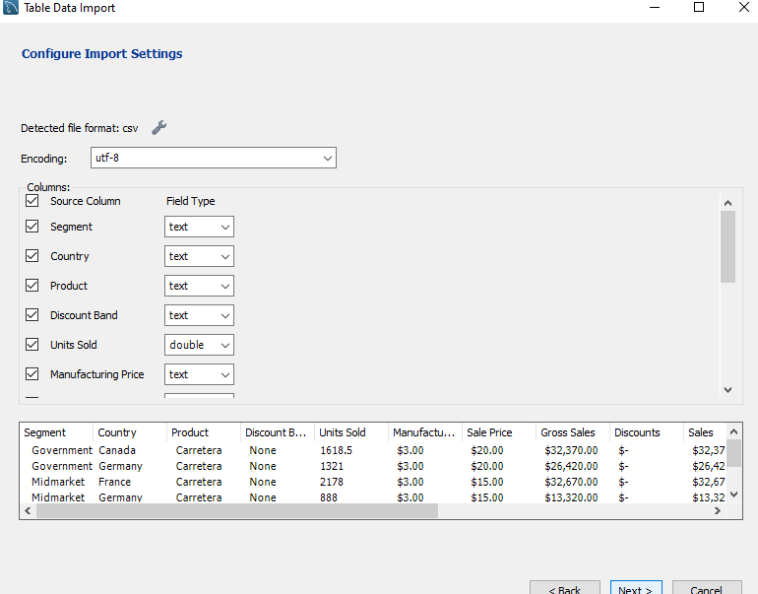

Slide 20
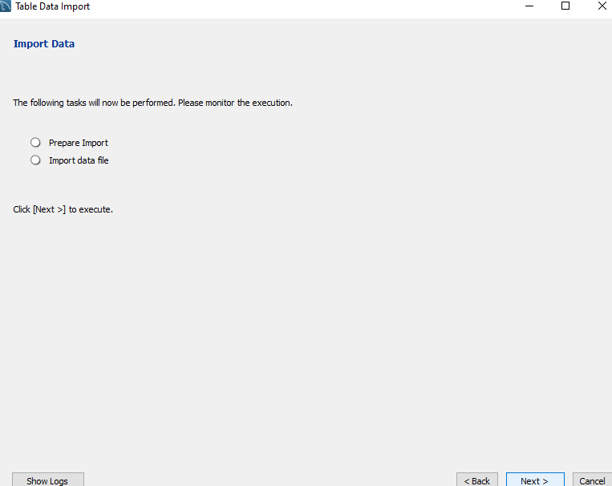
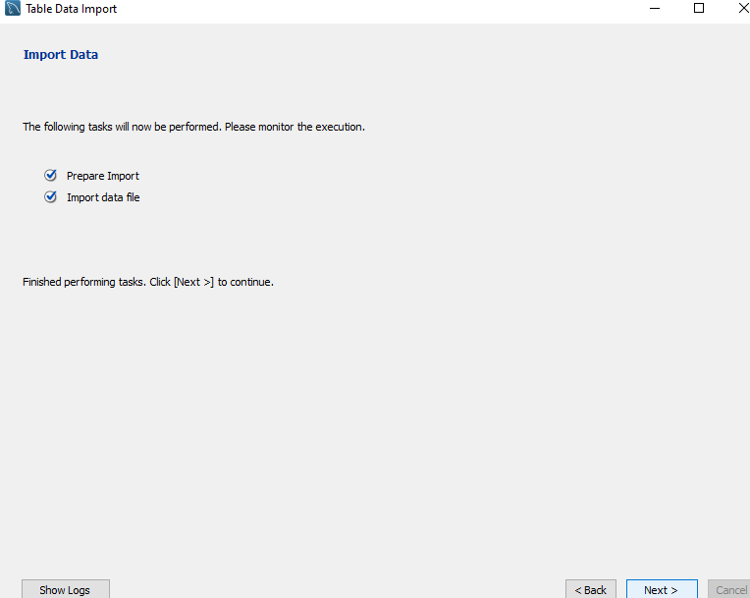
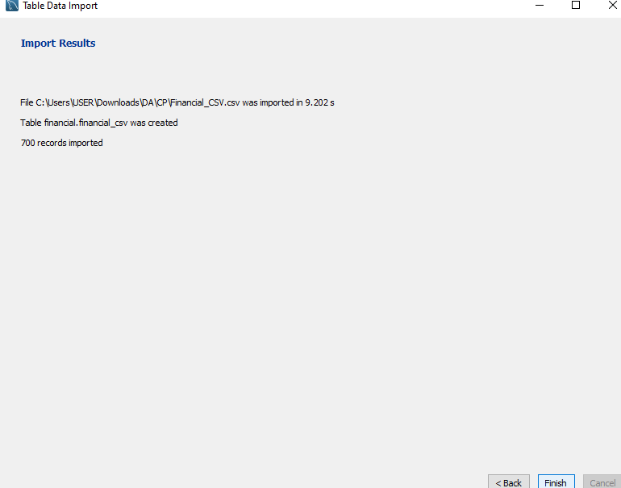

Slide 21
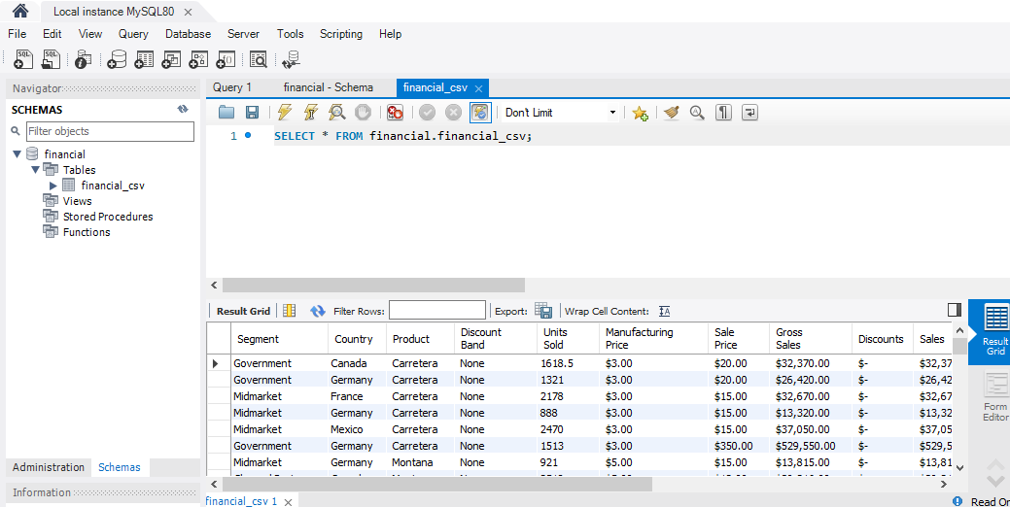
4 step: Verifying that the data is successfully inserted into My SQL, By Command – SELECT * FROM financial.financial_csv;

Slide 22
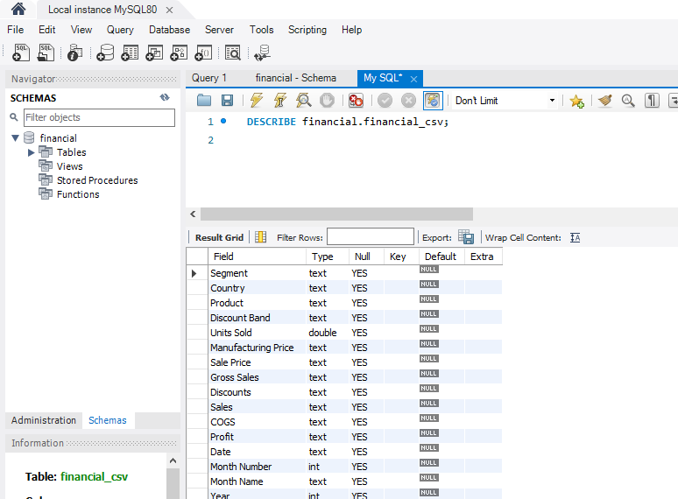
5. SQL Queries on Data
1) Analyzing column types of the Table. By Syntax – DESCRIBE financial.financial_csv;

Slide 23
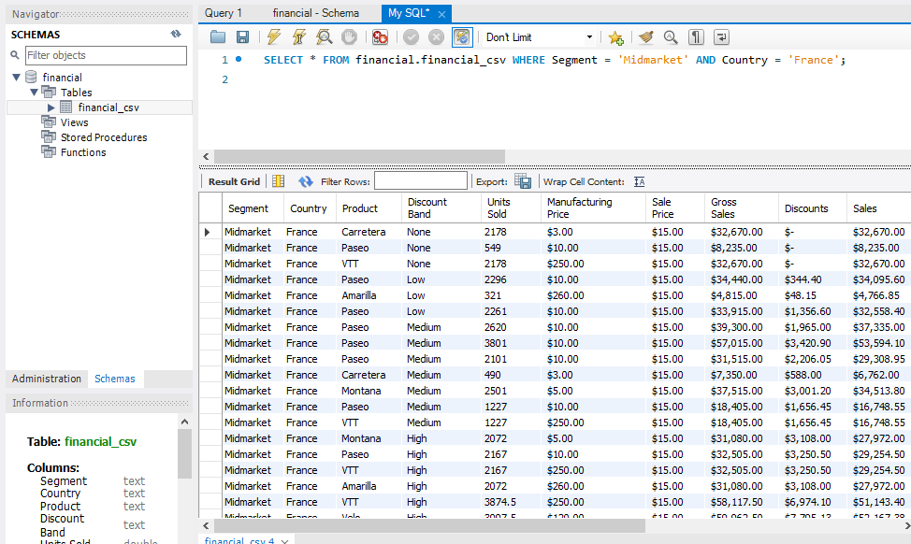
2) Analyzing the Data of Midmarket of France.
By Syntax – SELECT * FROM financial.financial_csv WHERE Segment = ‘Midmarket’ AND Country = ‘France’;

Slide 24
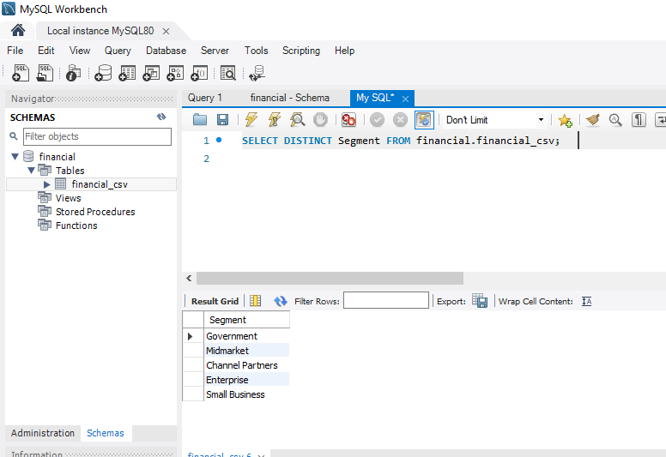
3) List of different segment. By Syntax – SELECT DISTINCT Segment FROM financial.financial_csv;

Slide 25
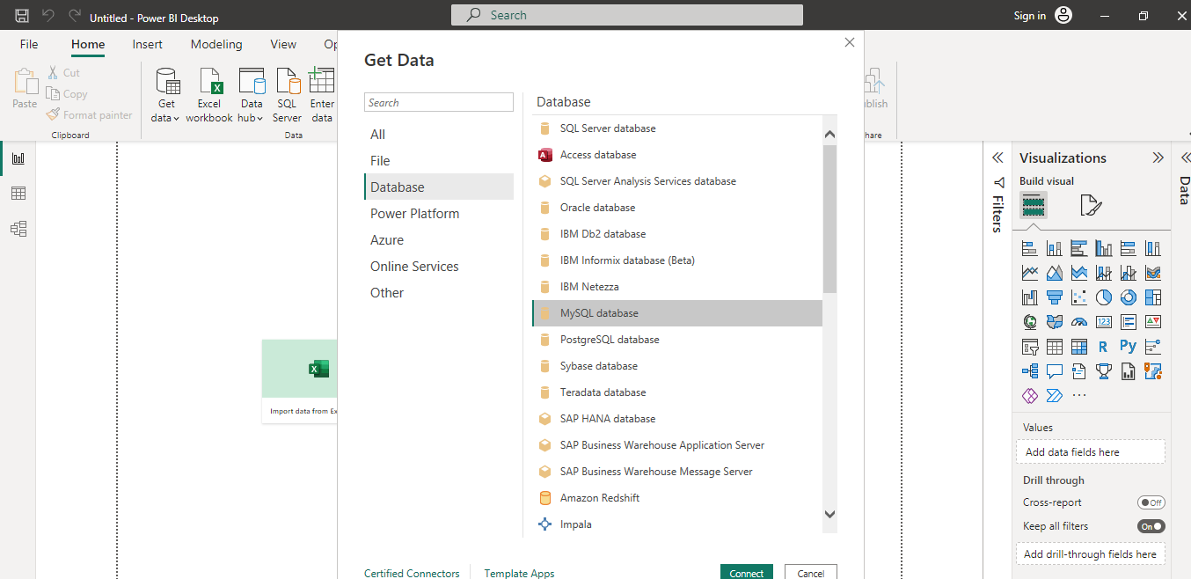
6. Data From My SQL Database to Power BI
1 step – Home> Get Data> Other Sources> Database> MySQL database> connect

Slide 26
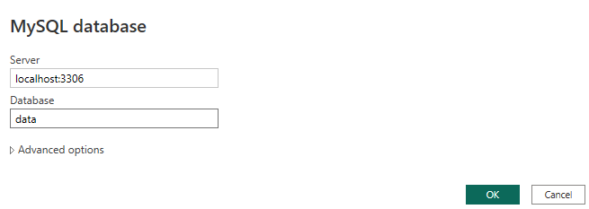
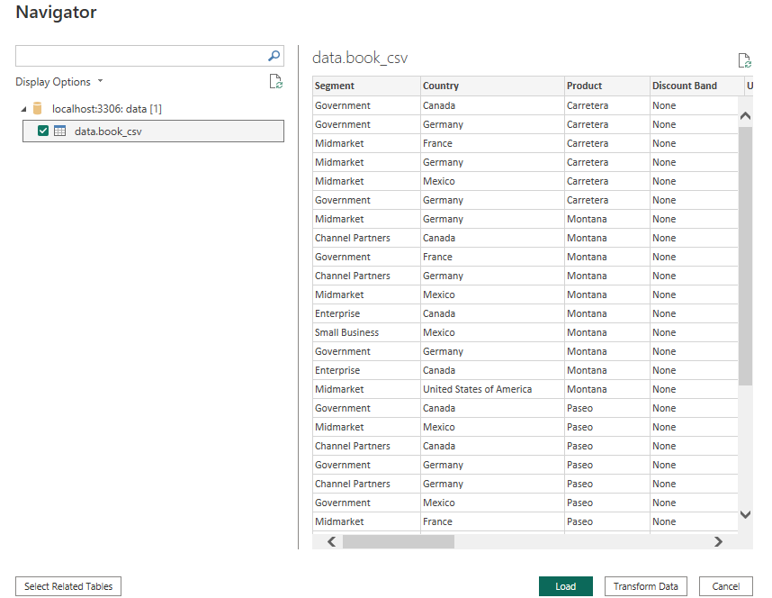
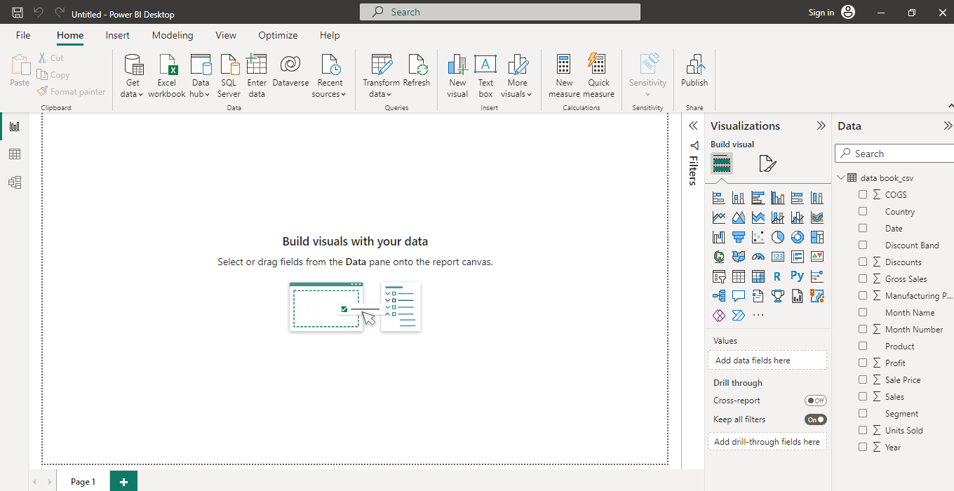
2 step – A new dialogue box will open – Enter Server & Database name> ok
3 step – Select table> load – Data is successfully imported in the Data pane.

Slide 27
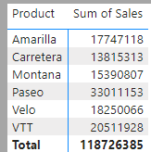
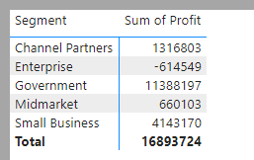
6. Interactive Dashboard By Using Visualization Tools In Power BI
1. Product wise Sales
2. Segment wise Profit

Slide 28
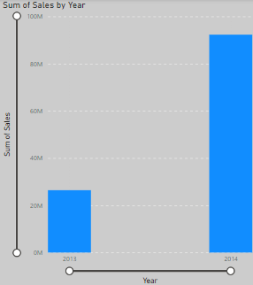
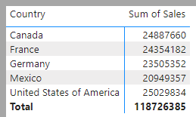
3. Yearly Sales
4. Country wise Sales

Slide 29
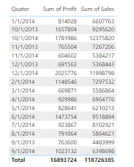
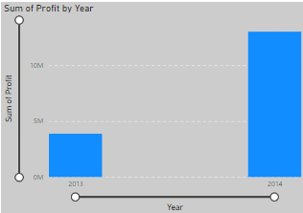
5. Profit and Sales by Quarters
6. Yearly Profit

Slide 30

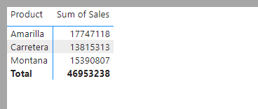
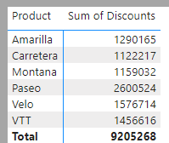

7. Top 2 Countries
8. Bottom 3 Products
9. Product wise Discount
10. No. of Units Sold Year Over Year

Slide 31
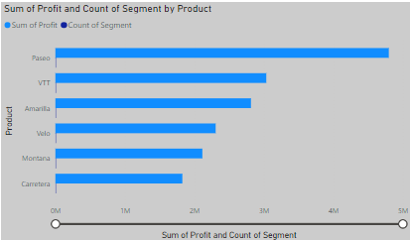
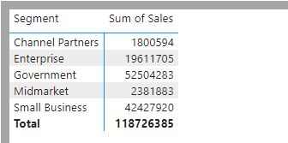
11. Segment Wise Product Sale
12. Segment Wise Product Wise Profit

Slide 32
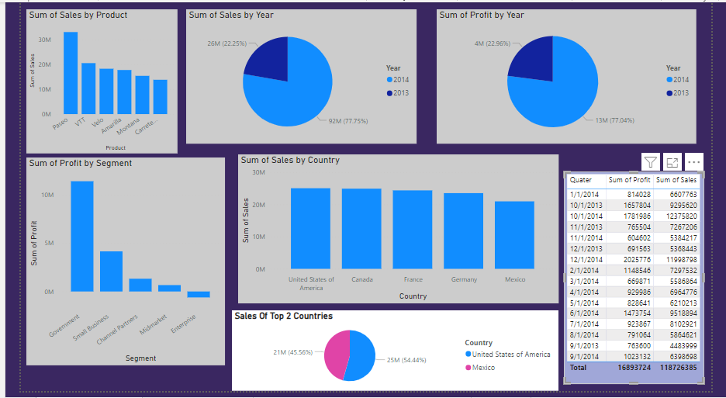
Answers For The Questions 8 By Interactive Dashboard Visualization In Power BI

Slide 33
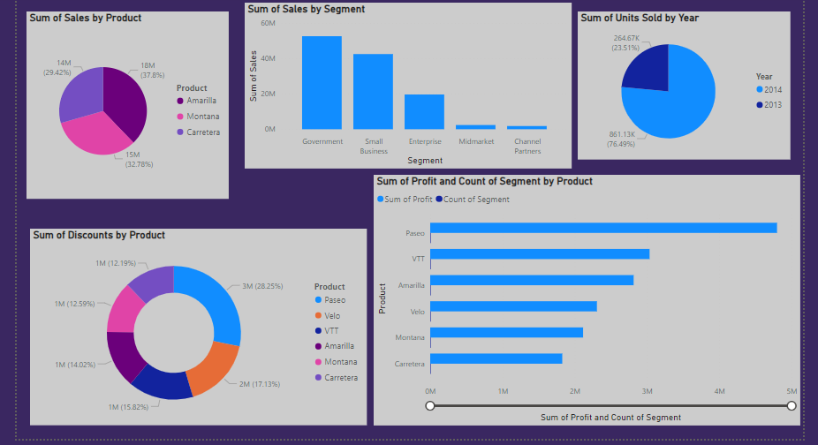
Answers For The Questions 8 By Interactive Dashboard Visualization In Power BI

Slide 34
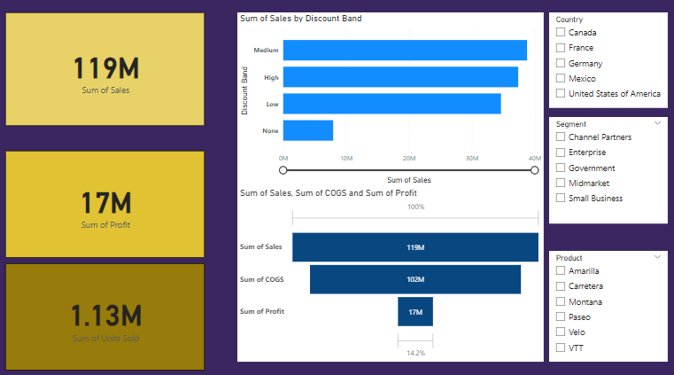
This Dashboard Shows - Sum of Sales, Profit & Units Sold – Effect of Discount on Sales – Overall Analysis of Sales

Slide 35
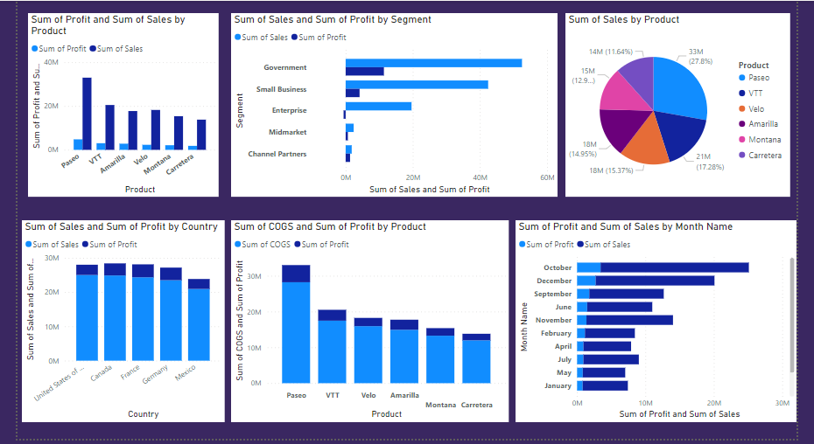
Sales And Profit Analysis

Slide 36
7. Conclusion And Inferences
The purpose of the Project was to identify sales based on analysis. It’s about the analyzing sales Dataset of Western Countries Financial Data. We have done analysis with the help of various tools which includes Microsoft Excel, MySQL Workbench and Power BI.
We have concluded with some useful insights of the data. By doing this Project I have learned many things and applied my skills of Microsoft Excel, SQL, Tableau, Statistics, Marketing & Retail Analytics, Finance and Risk Analytics and Power BI.

Slide 37
8. Endnotes
Reference Links :-
1. Western Countries Financial Data Analysis – Excel File (GitHub)
2. Data Visualization - power BI Dashboard File (GitHub)

